Slide 1
Sprint 2: Flu Vaccination Predictor Project
By ALPHA GROUP
Assimagbe Albert Raphael & Saad Ali
📊 Based on CDC H1N1 2009 Survey Data
Slide 1 of 10

Slide 2
Project Overview
Goal: Predict flu vaccination using CDC survey data (26,707 records)
Data Types: Behavior, demographics, health beliefs, and access to care
Main Objectives:
- Identify factors affecting vaccine uptake
- Build machine learning models
- Recommend actions for public health
Slide 2 of 10

Slide 3
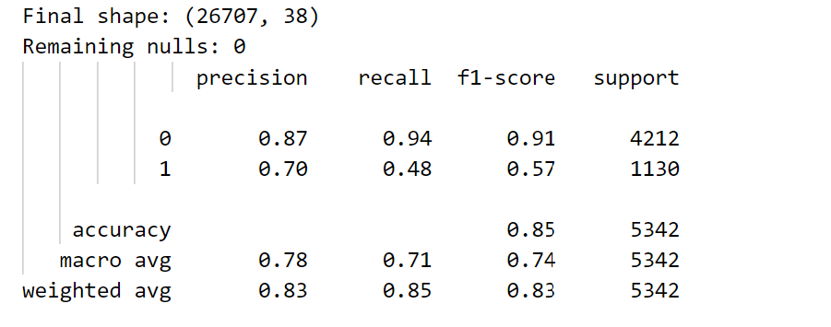
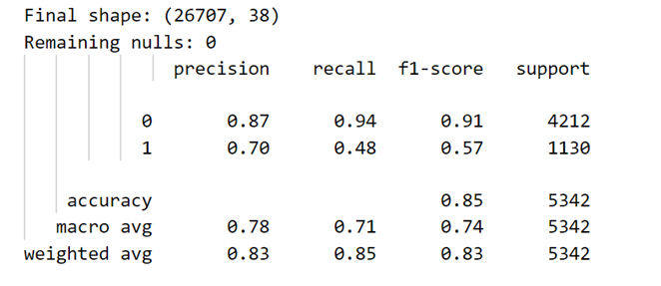
Compare Label vs One-Hot Encoding
Label Encoding
One-Hot Encoding
Model Performance
Both encoding methods (Label vs One-Hot) gave identical results:
- Accuracy: 85%
- Prediction quality:
- Excellent at identifying who won't vaccinate (94% correct)
- Moderate at identifying who will vaccinate (48% correct)
Slide 3 of 10

Slide 4
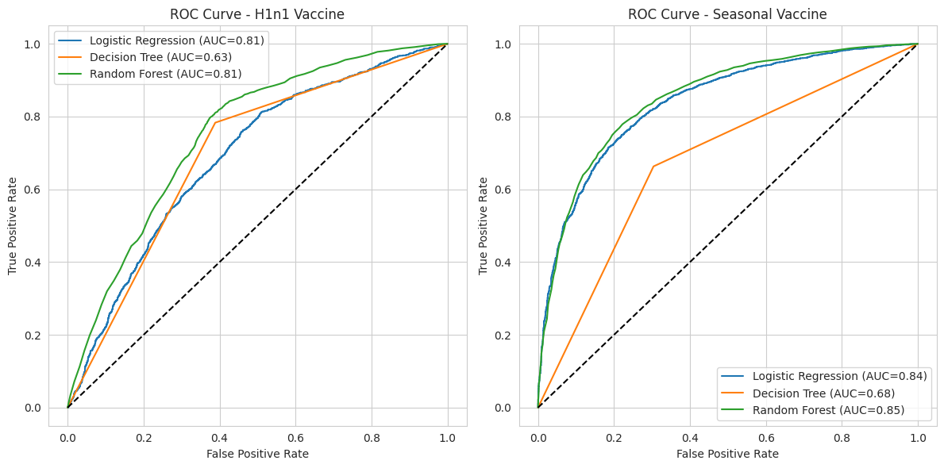
Baseline Model Performance Comparison
Slide 4 of 10

Slide 5
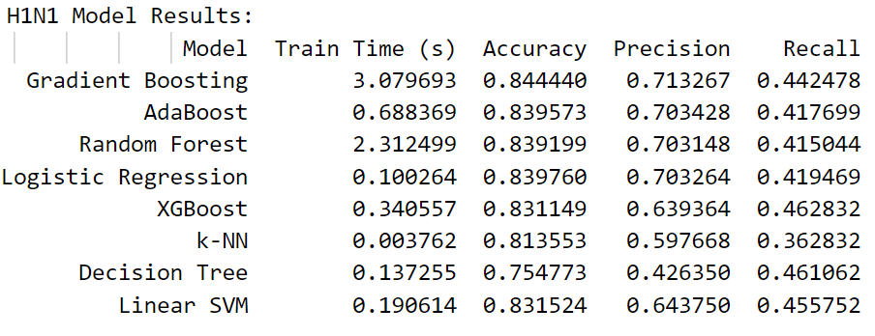
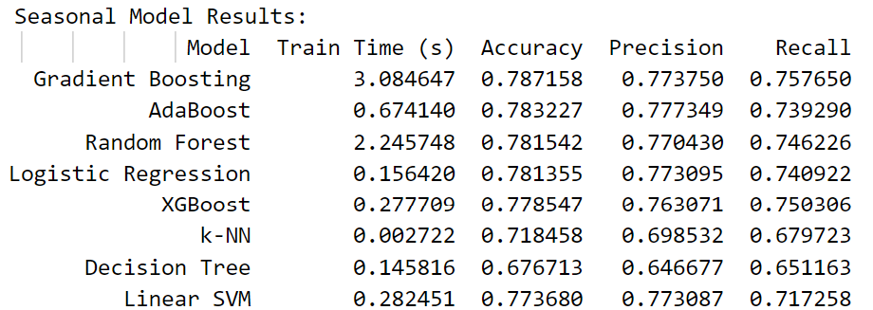
The Model Comparator For H1N1 and Seasonal Results
Slide 5 of 10

Slide 6
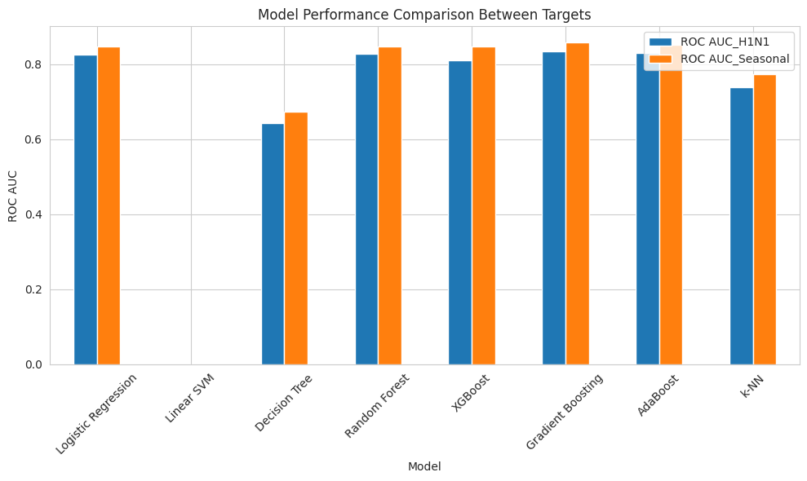
Model Performance Comparison Between Targets
Slide 6 of 10

Slide 7
Strengths & Weaknesses Of Models
Model | Strength | Weakness
Random Forest | High AUC, good overall balance | Higher memory usage
Gradient Boost | High performance and F1 score | Longer training time
Logistic | Very interpretable, fast, low memory | Slightly low recall and AUC
Slide 7 of 10

Slide 8
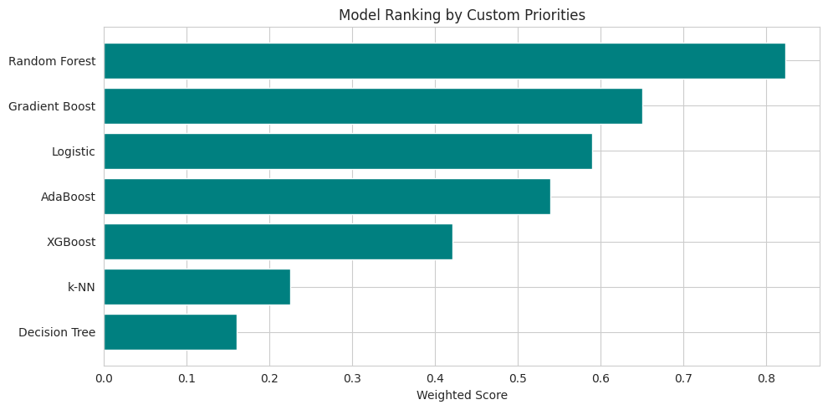
Best Models by Priority
Slide 8 of 10

Slide 9
Model Selection Guide
Use Random Forest for real-world balance
Use Gradient Boosting when accuracy is priority
Use Logistic Regression when interpretability matters
Slide 9 of 10

Slide 10
Conclusion
Gradient Boosting and Random Forest are top models
Model insights can guide smarter public health actions
Future work will focus on visualization and deployment
Slide 10 of 10

